Slide 1
PyInstaller: Injection Story
by Rakovsky Stanislav

Slide 2

C:\Windows\System32>whoami desktop-c4tz102\stanislav
Rakovsky Stanislav, 22 y.o.
Something_interesting analyst in Positive Technologies
https://disasm.me

Slide 3

Why? For what?
Education part: how does PyInstaller work. Investigation interest.
Utility part: Make our product analysis more complicated (non-triviality, security through obscurity).
Practical part: Add our module in other project without recompiling/reassembly: debugger, RickRollizer, unwanted/malicious behaviour, PyInstaller-worm.

Slide 4

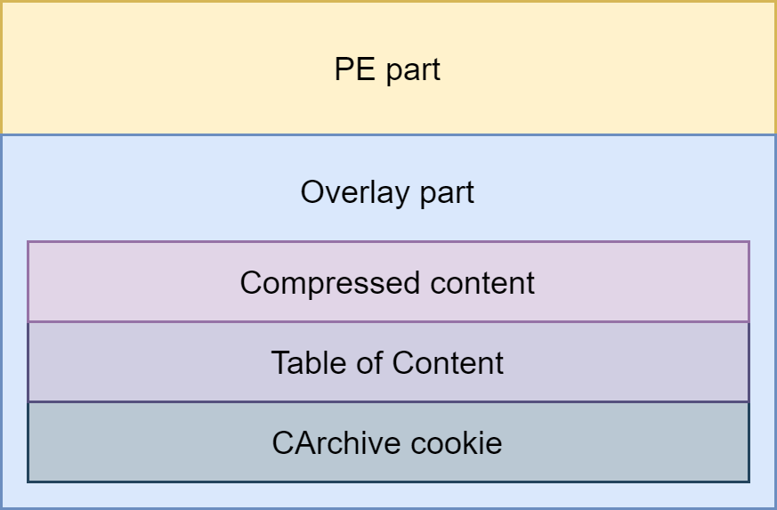


Well. What about our inject options?

Slide 5
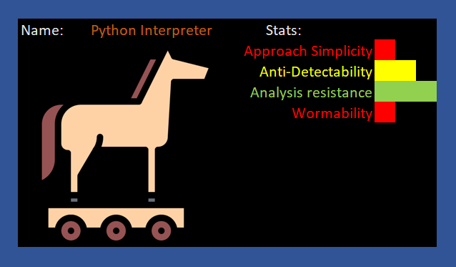

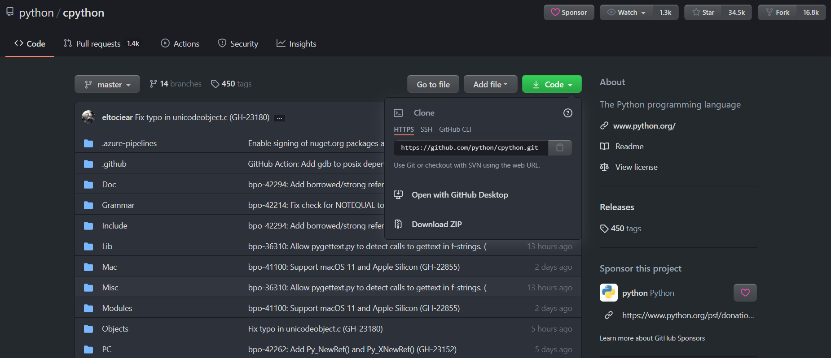
Inject. Interpreter
Obviously, why don't we rebuild the Python interpreter?
https://github.com/python/cpython

Slide 6
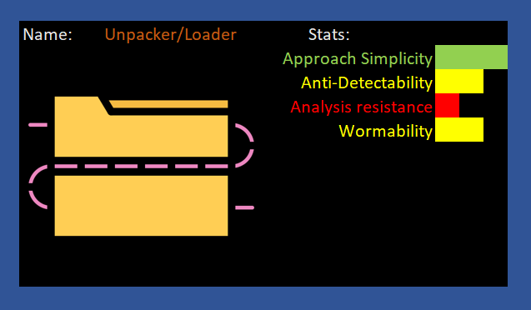
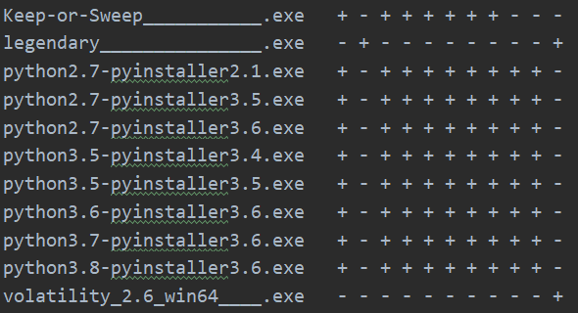
Inject. Loader
Build our custom loader
Replace loader with a custom in other PyInstaller executables

Slide 7
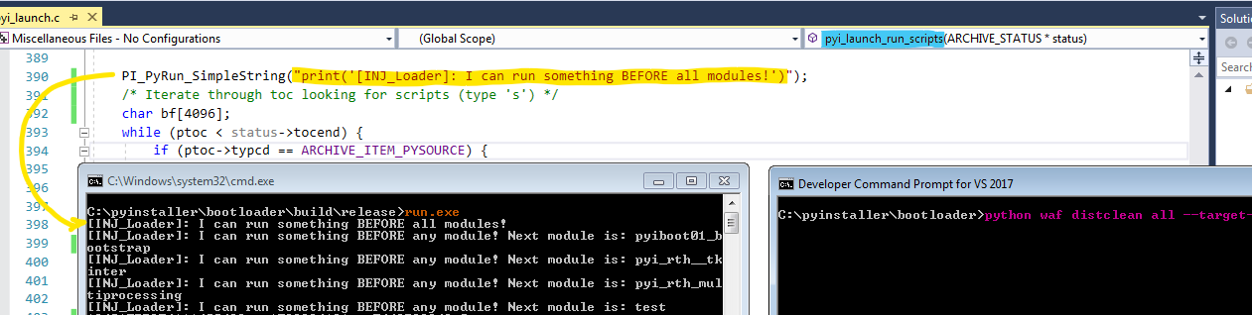
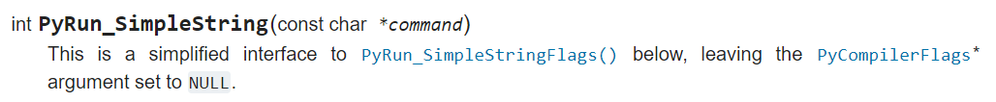
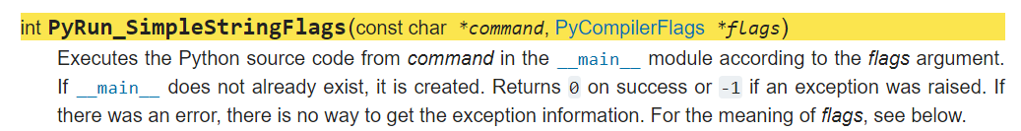
Loader. Practice

Slide 8
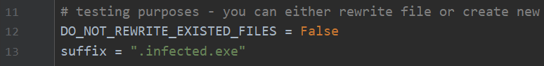
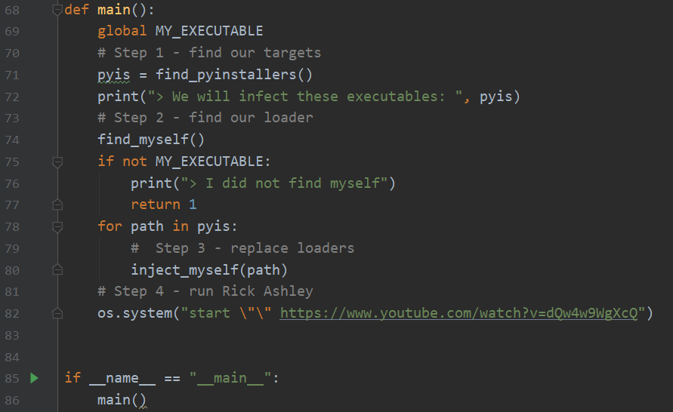
Loader. Practice

Slide 9
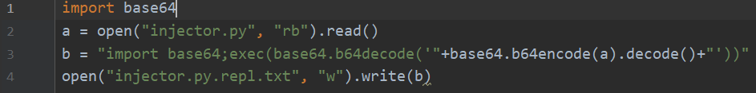
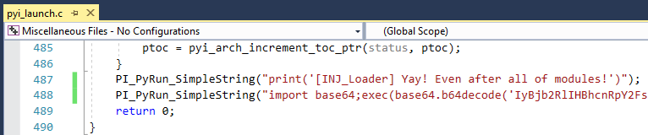
Loader. Practice

Slide 10
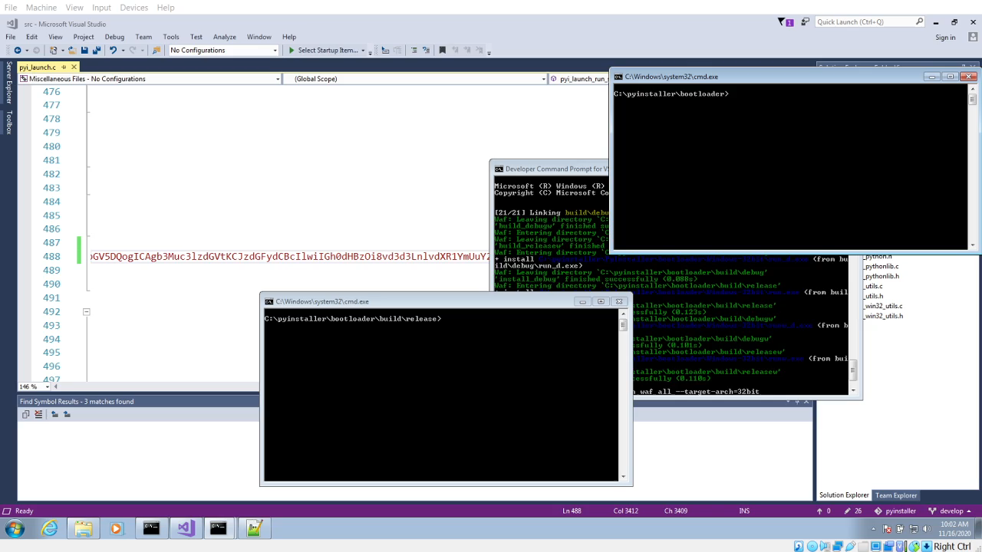

Slide 11
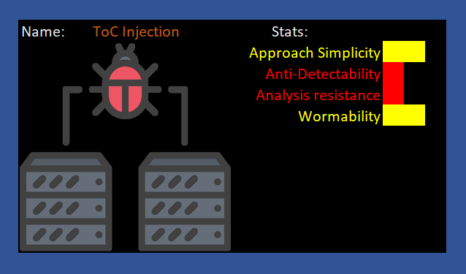

Inject. ToC
We need to change the table of content.
But for this we should know how to properly change the structure without ruining it

Slide 12
How PyInstaller works on Windows. CArchive Cookie
Magic
Length of Package
Table of Content (ToC)
ToC Length
Python Version
Python Library Name

Slide 13
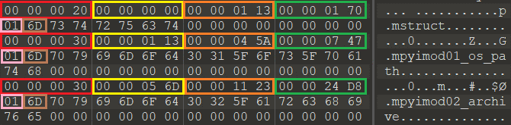
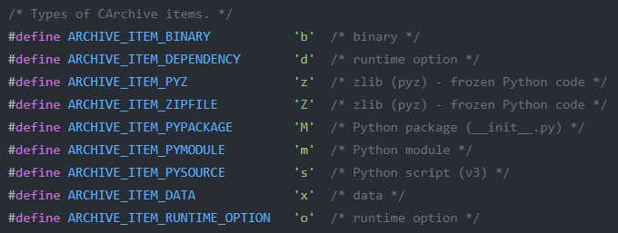
How PyInstaller works on Windows. ToC
This structure length
Relative position of data
Length of compressed data
Length of uncompressed data
IsCompressed flag
Type of data
Name of data

Slide 14
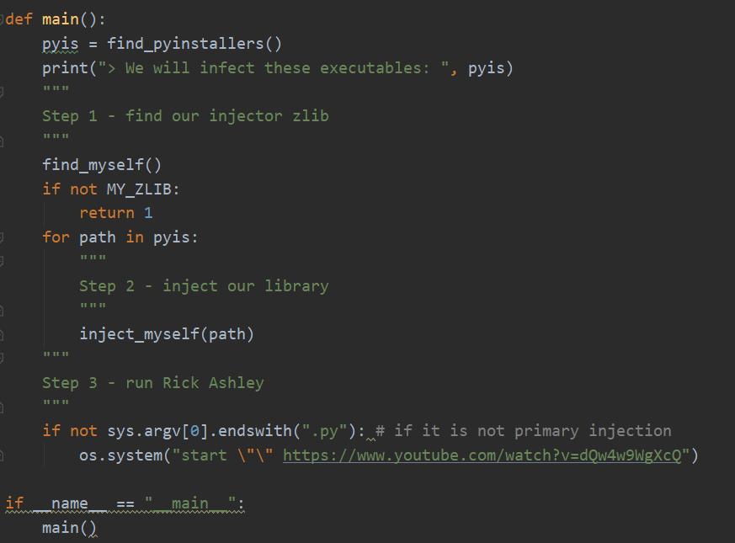
ToC. Practice

Slide 15
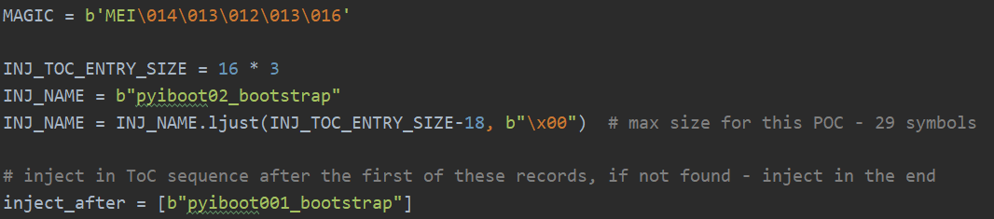
ToC. Practice

Slide 16
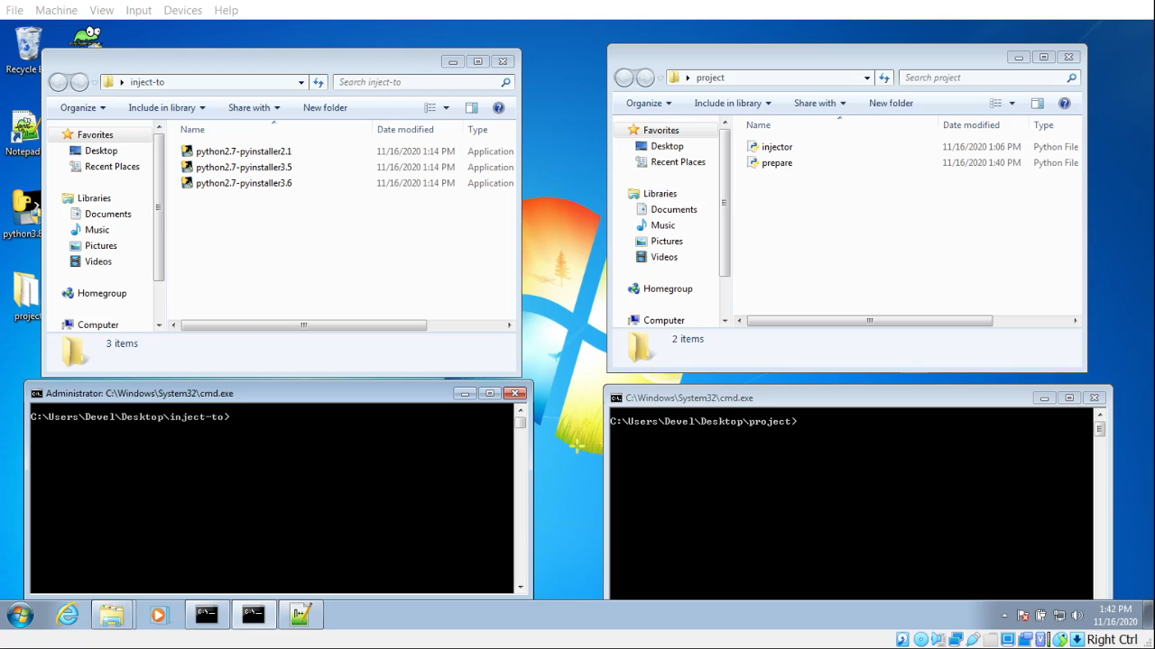
ToC. Practice

Slide 17
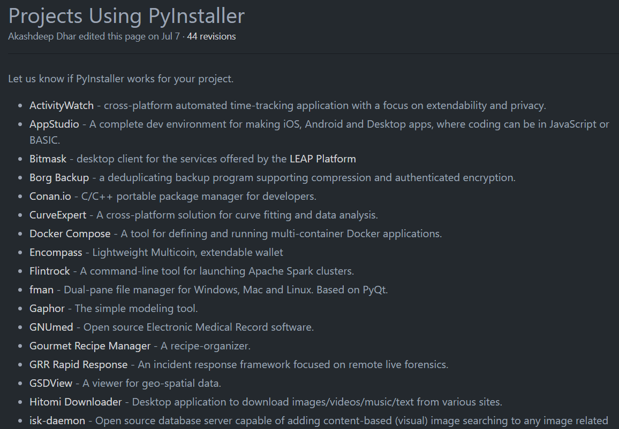
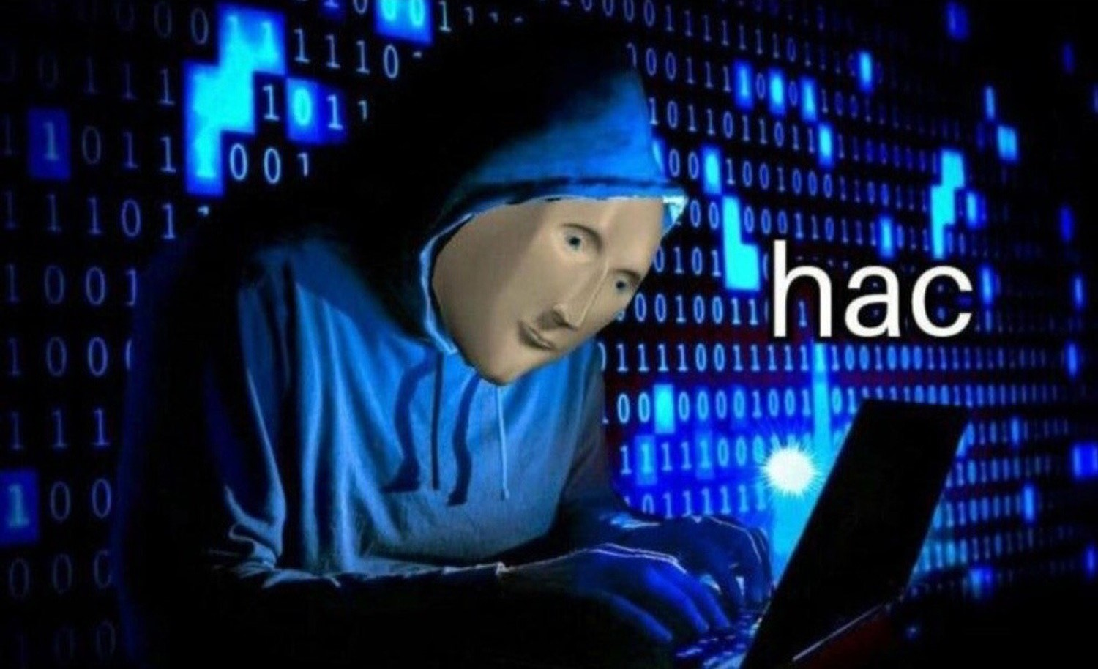
Okay, we can inject now. What’s next?
github.com/pyinstaller/pyinstaller/wiki/Projects-Using-PyInstaller

Slide 18
Resources worth listing.
github.com/rakovskij-stanislav/pyinstaller-injection-story - PoCs and other things
https://github.com/pyinstaller/pyinstaller
Python/C API Reference Manual
https://github.com/extremecoders-re/pyinstxtractor - PyInstaller content extractor
Icons used in this presentation

